Slide 1
Transformation guidance from farm solutions to add-in model
Name
Title
Company

Slide 2
Agenda
Element replacement approaches
Transformation process
Transformation approaches
Farm solution considerations

Slide 4
Recommendations
Understand impact of farm solution
Make sure that you have detailed inventory
Use analyses tooling for technical analyses
Transform end user experience, not code
Notes:
Vesa

Slide 5
Transformation process

Slide 6





Approaching add-in implementations
Readiness
Assessment
Planning
Implementation
Deployment
Readiness with add-in model topics
Hosting decisions
Network impact analysis
Development model readiness
Analyze possible existing solution usage, including both code and functionality
Concentrate on business and functional requirements, not on technology
Add-In model solution planning and design
What patterns and models are used for different solutions
What solutions can be converted to out of the box capabilities?
Detailed technical planning
Actual add-in model solution implementation
Typical development process, including testing
Add-In solution deployment
Existing content retrofitting
Farm solution retraction
Time for accurate estimates

Slide 7
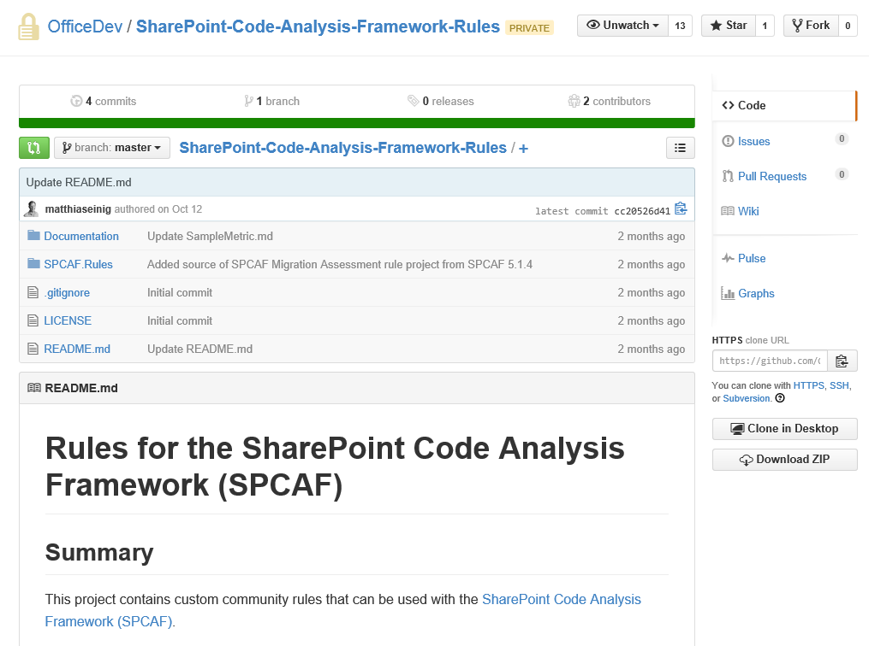

SPCAF Migration Assessment – Analysis rules
http://aka.ms/spcafmarules
Analysis rules for the migration assessment are open source for input from community
Enables faster development cycles and contributions from community
Located under the official Office Dev location in the GitHub
Join us on the transformation rule development!
Notes:
Vesa

Slide 8
SPCAF tooling in practice
Demo
Notes:
Vesa

Slide 9
Transformation Approaches

Slide 10
Transformation Approaches
In Place
Swing
Pros:
Less customer impact (overall)
Less hardware and Tooling required
Can be performed with no down time
Cons:
Harder to track progress
Increased possibility of “Orphans”
Can be longer overall execution time
Pros:
Total isolation from Production Environment until ready
Clean environment (no “Cruft” from previous FTC code
Cons:
Increased hardware and tooling requirements
Increased downtime for users (can be minimized, but not eliminated)
Notes:
Steve

Slide 11
Ways to minimize overall transformation time
Perform needed operations using server side code
Use parallel processing of sites either by scaling to multiple farms or using adding threads which process the sites
Too many threads accessing one farm can cause though additional performance challenges

Slide 12
Replacements for different customization types

Slide 13
Challenge?
Existing sites are dependent on full trust code…
Existing content is dependent on declaratively deployed artifacts (Content Types, Site Columns)
Notes:
Steve

Slide 14
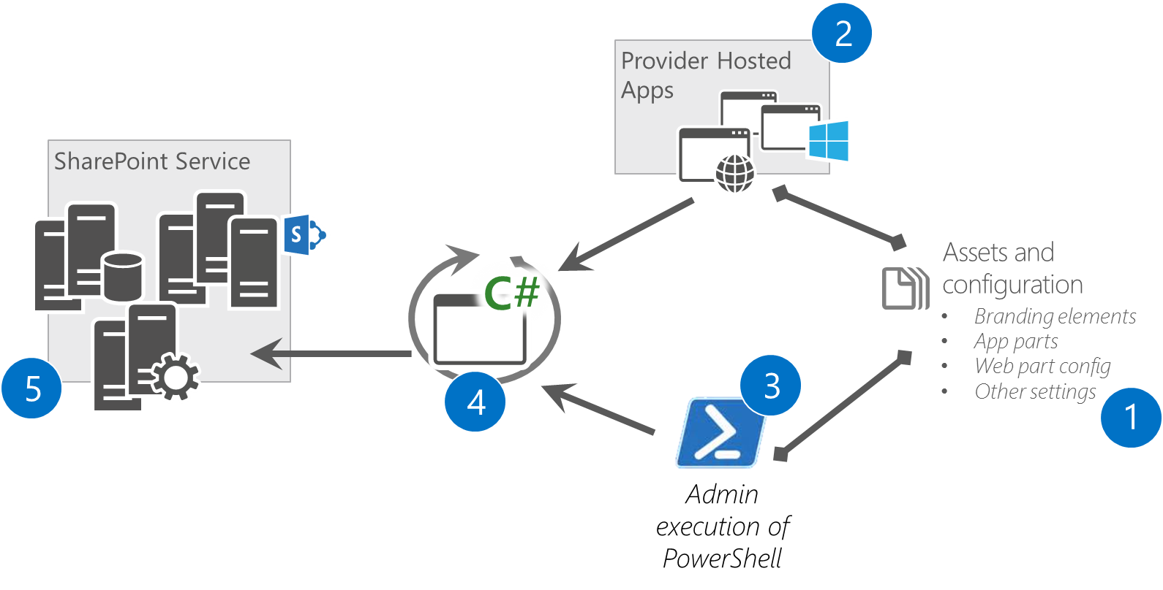
Replace page layouts and master pages
Gradual reduction of FTC dependency from page layouts and master pages
Implemented as remote operation to control the elements used on sites
Notes:
Steve
NOTE: Deploy as new artifact – don’t try to just use the same names but copy to site. Confusing to say the least, conflicting at worst .

Slide 15
Replacement of web parts and controls
Remote operation to replace web parts on page
Replace with pre-configured out of the box web parts
Replace with add-in part instances
Embedded JavaScript
Add-in part installation requires enabling of add-in side loading in the site
Can be enabled only at the needed time by using CSOM with feature activations
Notes:
Steve

Slide 16
Add-in pre-register and side loading
Demo
https://github.com/OfficeDev/PnP/tree/dev/Samples/Core.SideLoading
Notes:
Steve

Slide 17
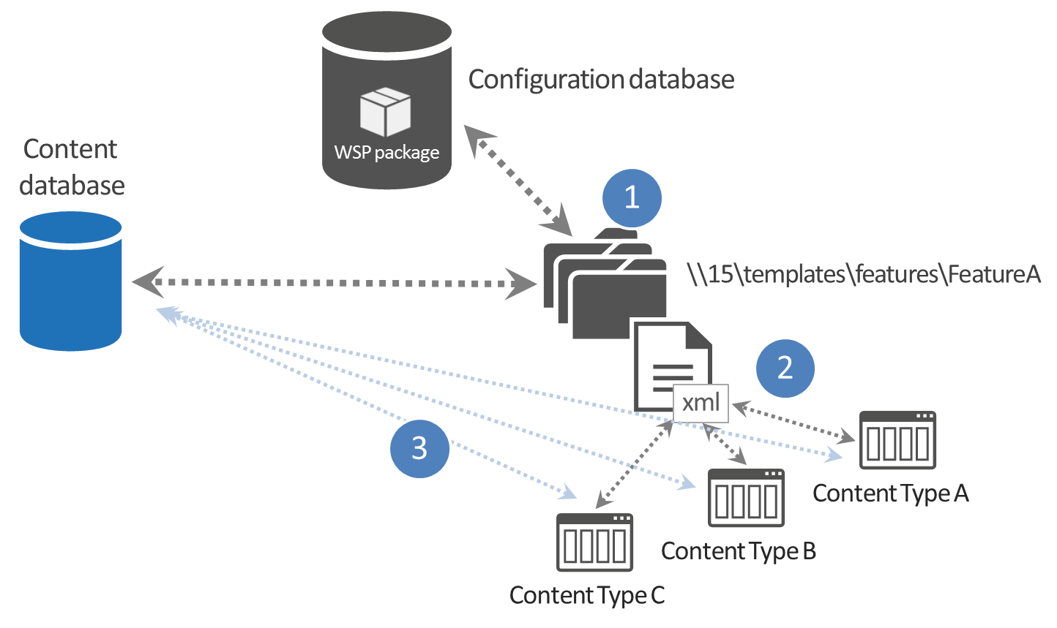
Site columns and content types
If created declaratively using feature framework, only solution would be a content migration using third party tooling
If created using code, no actual dependencies on FTC code or farm solutions
Known Issue. We have a plan to address this with new product capability
Notes:
Vesa

Slide 18
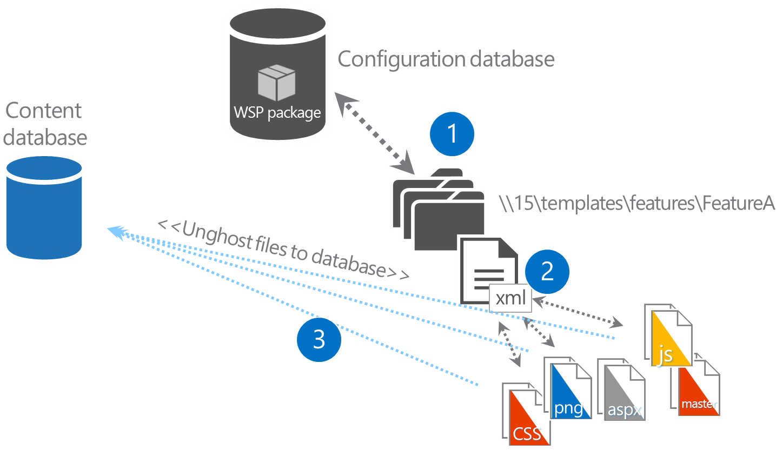
Modules (Feature Framework)
These are essentially files deployed to the site
You should follow the same “remote provisioning pattern” that we outlined for application artifacts such as .webpart files, page layouts and master pages.
EITHER: Touch the file to copy to Content Database OR delete the file and copy afterwards.
Notes:
Vesa

Slide 19

Site Templates & Web Templates
Site Templates & Web templates themselves aren’t the real problem. It is the FEATURES and ARTIFACTS within that you need to think about
These should be analyzed just like any other farm solution
Replacement method based on artifacts contained within
Problematic case sample: Web template replaces out of the box default.aspx page
Notes:
Vesa

Slide 20

Timer jobs
No ability to create and manage timer jobs within SharePoint, BUT
Scheduling can be done using any external platform
Access to SharePoint and other services using CSOM/REST
Scheduled execution which accesses the needed resources from the SharePoint service and performs the required automation.
Can use either specific account for connection or oAuth based add-in only token approach
SharePoint Service
2
Provider Hosted add-ins
1
Remote Timer job
Notes:
Vesa

Slide 21
Remember!
Deactivate your custom features BEFORE you retract the solution…
It leaves references behind if you do not. Your next upgrade will FAIL.
Notes:
Steve

Slide 22

Case of a bad headache?
Custom fields types
Custom site definitions
Custom list definition
Moving from publishing to non-publishing sites
Will require content migration…
Notes:
Vesa

Slide 23
“I’m moving to cloud, couldn’t I transform as part of the move?”
Yes…
You could combine these two steps to one big bang approach, but solving possible issues could be more difficult. Doing add-in model move as separate step is less risky.

Slide 24
Considerations for current farm solutions

Slide 25

Recommendations for farm solutions
Recommendations for following components
Content types and site columns
List templates
Field types
Recommendations to avoid future maintenance and rework of your deployment

Slide 26

Content Type and site columns challenge
What
Rather than using feature framework elements in farm solution, it is recommended to provision site columns and content types using code
Why
Objects are created directly to the database (unghosted) without any dependencies on files in file system
How
Use code called from feature receiver to create needed elements
Notes:
Title: Extending oob web parts
Time: 1 minute
You have to end up writing code nayways when you want to upgrade from V1 to V2 of your solution. Why not just write the code.

Slide 27
Content type and site columns with dependency Not recommended approach
Configuration database
Manifest xml in the solution package introduces the feature framework elements.
Content database
WSP package
1
\\15\templates\features\FeatureA
2
Feature framework feature with element xml files for content type and site columns.
xml
Provisioned content types And site columns have dependency on element xml files
3
Content Type A
Content Type B
Content Type C

Slide 28
Content type and site columns without dependency Recommended approach
Configuration database
Manifest xml in the solution package introduces the feature framework elements.
Content database
WSP package
1
\\15\templates\features\FeatureA
2
Feature with feature receiver creating content types and site columns directly to content database using code
xml
Content Type A
Content Type B
3
Content types do not have any dependency and farm solution can be retracted without any impact to them
Content Type C
Notes:
2

Slide 29
List template challenge
What
You should avoid custom list templates for your list instances
Why
Custom list template has unique identifier and it creates dependency on the list instances to the schema.xml file of the list template
How
Consider using code to provisioning specific instances or use custom schema option with instances. List events for newly created lists in sites
Notes:
2

Slide 30
Custom field challenge
What
Do not use custom fields with you farm solutions
Why
Data stored in the database will have dependency on the custom field type, which will cause challenges in migration scenarios
How
Consider using only field controls for presentation or use client side rendering for list editor overrides
Notes:
2

Slide 31
Recommendations
Understand impact of farm solution
Make sure that you have detailed inventory
Use analyses tooling for technical analyses
Transform end user experience, not code
Notes:
Vesa

Slide 32
Questions?

Slide 33
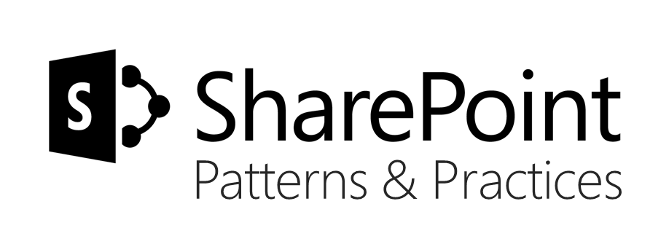
Sharing is caring…
Reusable code samples
Guidance documentation
Monthly community calls
Case Studies
SharePoint Framework
SharePoint add-ins
Microsoft Graph
Remote API access
http://aka.ms/SharePointPnP

Slide 34


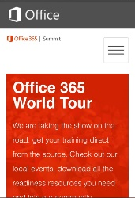
dev.office.com
Sign up
http://dev.office.com/getting-started
Explore
http://apisandbox.msdn.microsoft.com
Get trained http://dev.office.com/training

Slide 35


Feedback
Office 365 Network Share you best practices and join conversations
https://www.yammer.com/itpronetwork
Stackoverflow Ask deep technical questions to a world-wide set of developers
http://stackoverflow.com/questions/tagged/ms-office
UserVoice Provide suggestions of what you want in future versions
http://officespdev.uservoice.com/

Slide 36


© 2015 Microsoft Corporation. All rights reserved. Microsoft, Windows, and other product names are or may be registered trademarks and/or trademarks in the U.S. and/or other countries.
The information herein is for informational purposes only and represents the current view of Microsoft Corporation as of the date of this presentation. Because Microsoft must respond to changing market conditions, it should not be interpreted to be a commitment on the part of Microsoft, and Microsoft cannot guarantee the accuracy of any information provided after the date of this presentation. MICROSOFT MAKES NO WARRANTIES, EXPRESS, IMPLIED OR STATUTORY, AS TO THE INFORMATION IN THIS PRESENTATION.

